Slide 1
4.2 Women’s participation in economic and political activities
Answer all the questions on the paper. If you need more space, use the last blank page.

Slide 2
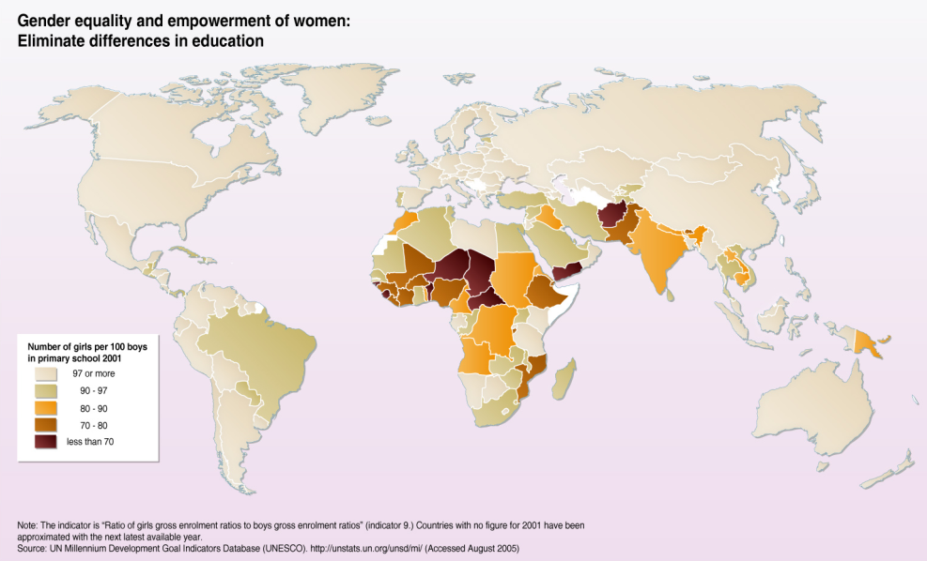
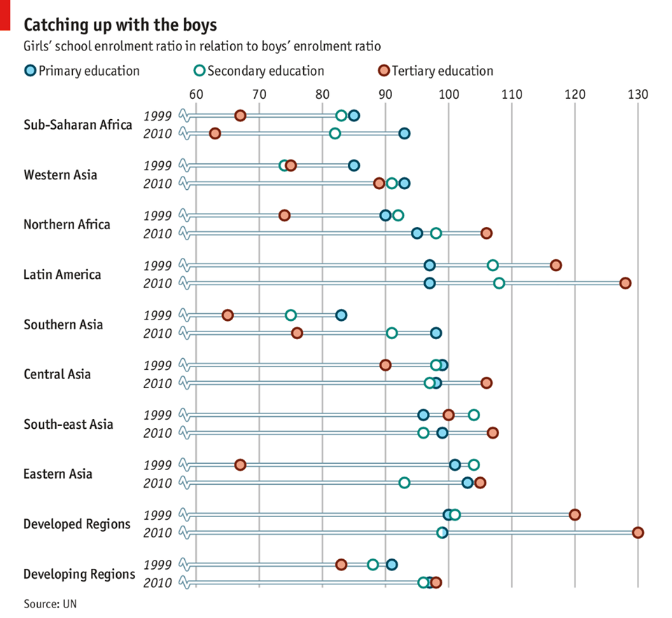
Describe the pattern seen on the map [3]
2. i) Describe the trend for girls’ enrolment in Primary Education. [3]
ii) Identify one anomaly [1]
3. Explain where the situation is the less beneficial for Girls [3]

Slide 3
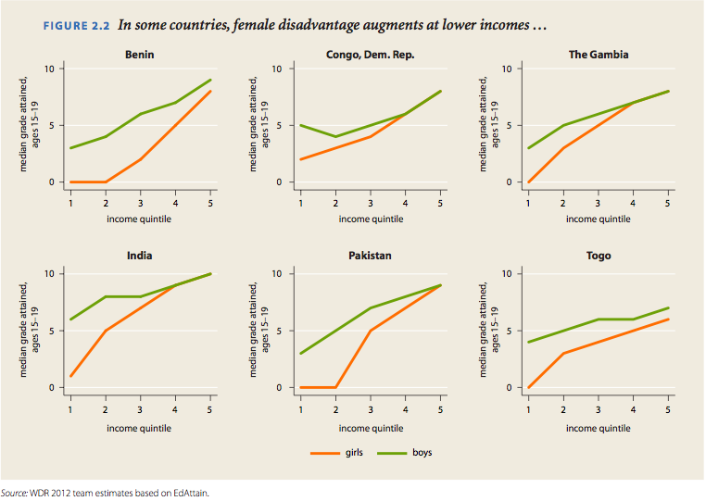
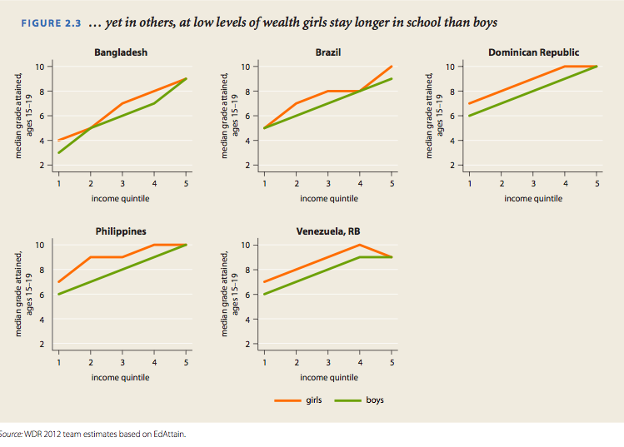
The income quintile is a division of the population in 5 groups, by income (1 being the lowest and 5 the highest)
The median grade attained refers to the class grade (1 to 12)
4. Describe the pattern showed in the first 6 graphs [2]
5. Describe the pattern showed in the last 5 graphs [2]
6. Suggest 2 reasons that could explain this opposing pattern [2X2]

Slide 4
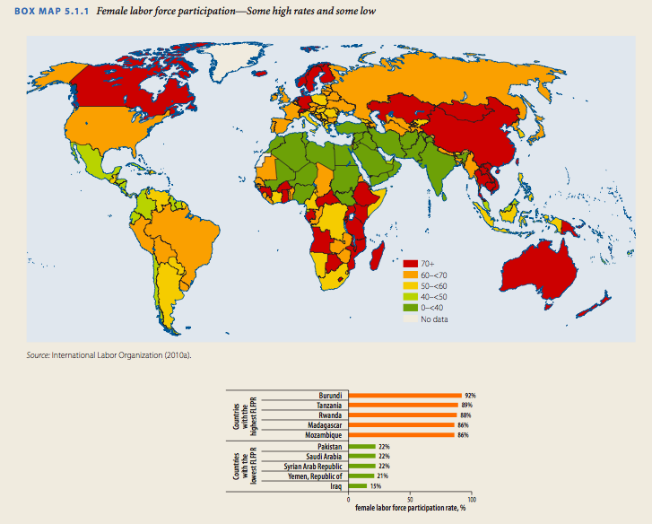
7. Describe the pattern of the Female labor participation [3]
8. Suggest a factor explaining the low female labor participation in the dark green countries [2]
9. Suggest a factor explaining the very high female labor participation in some African countries [2]

Slide 5
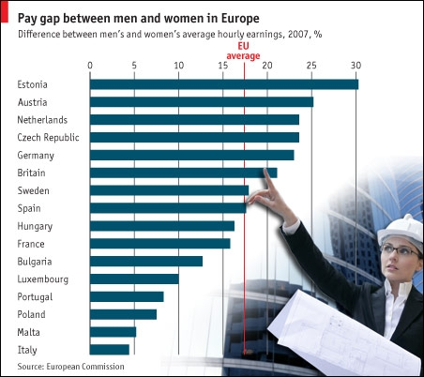
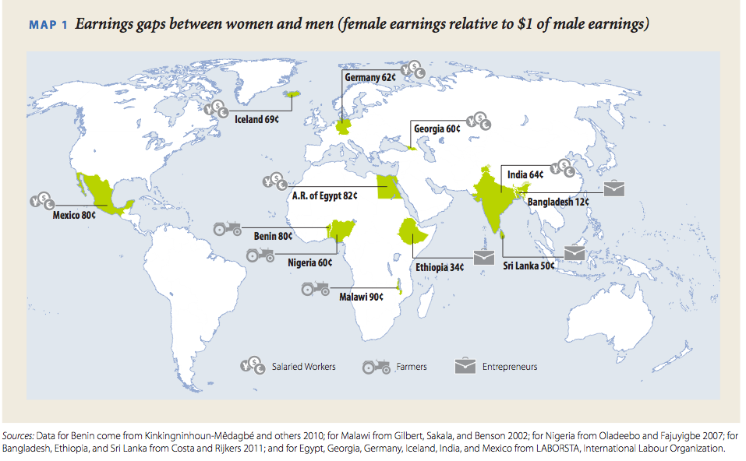
There are men’s jobs and women’s jobs: Employment segregation by gender
There are significant and systematic differences between men’s and women’s jobs, whether across sectors, industries, occupations, types of jobs, or types of firms (the phrase “employ- ment segregation by gender” refers to these differences). Women are more likely than men to work in agriculture (37 percent of all employed women, against 33 percent of all employed men) and in services (47 percent of all employed women, against 40 percent of all employed men). The opposite is true for manufacturing. Women also are overrepre- sented among unpaid and wage workers and in the informal sector. Women account for about 40 percent of the total global workforce, but 58 percent of all unpaid work, 44 percent of wage employment, and 50 percent of informal employment.
UN World Development Report 2012
10. Explain why we find a pay gap between men and women everywhere in the world [5]

Slide 6
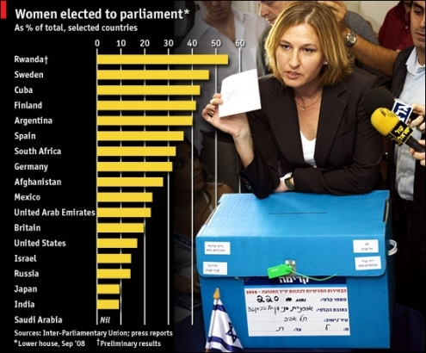
11. Is there a correlation between the % of women elected to parliament and GNI/capita of a country? Check it using a Spearman’s corelation test! [4]
12.Choose another factor that could be correlated and perform another Spearman’s correlation test. [3]
13. Suggest one way to have a better representation of women in politics. [2]

Slide 7
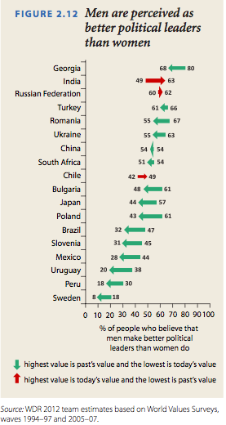
14. i. (Figure 2.12) Describe the trend showed on the graph [2]
ii. Identify one anomaly [1]
15. Explain what gender representation are associated with the different portfolio (ministers) and that could explain the unequal female participation. [3]

